Slide 1
Image Restoration
AI2019 Proj 2

Slide 2

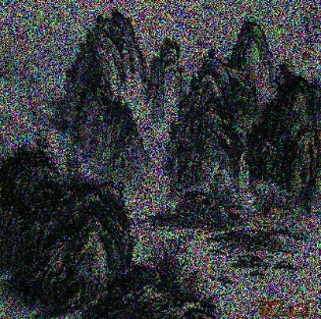
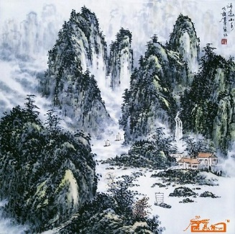
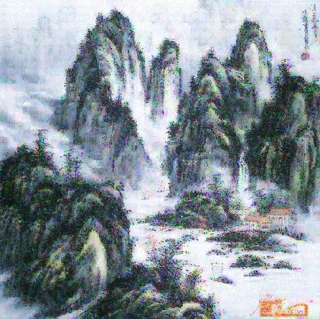



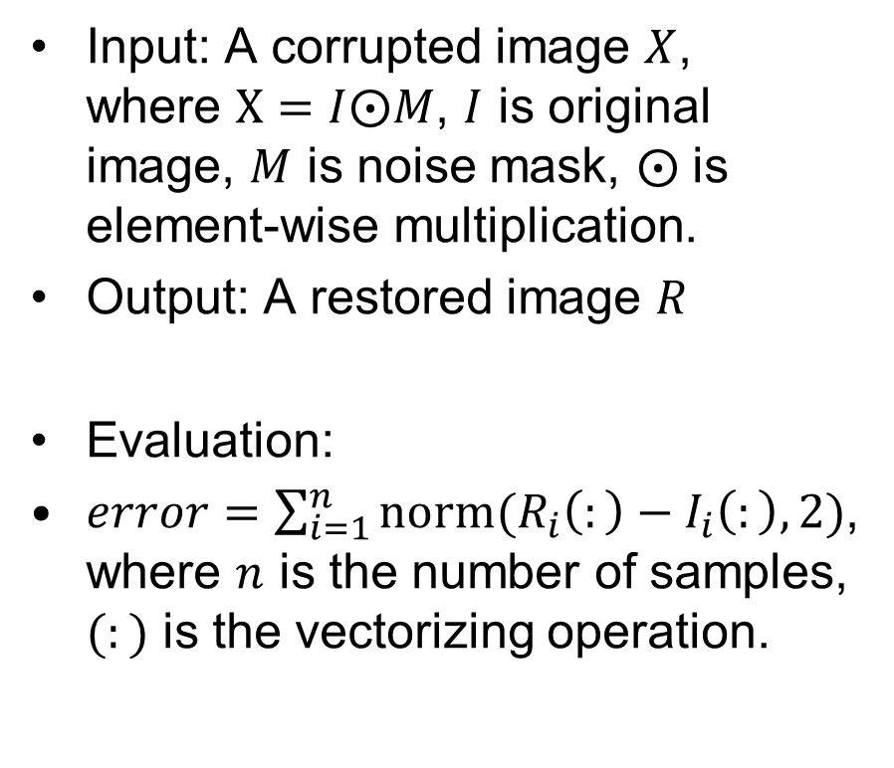



Image Restoration
Input: A corrupted image $X$, where $X=I⨀M$, $I$ is original image, $M$ is noise mask, $⨀$ is element-wise multiplication.
Output: A restored image $R$
Evaluation:
$error=\sum_{i=1}^{n}{norm(R_{i}\left(:\right)−I_{i}\left(:\right),2)}$, where $n$ is the number of samples, $(:)$ is the vectorizing operation.
$$M$$
$$⨀$$
$$X$$
Restore
$$I$$
$$R$$
$$error$$

Slide 3




Corrupted Image Generation
0 | 1 | 0 | 1 | 0
0 | 1 | 0 | 0 | 0
0 | 0 | 0 | 0 | 0
1 | 1 | 0 | 0 | 0
0 | 0 | 0 | 0 | 0
0 | 0 | 1 | 0 | 0
1 | 0 | 0 | 1 | 0
0 | 0 | 1 | 0 | 0
1 | 0 | 0 | 1 | 0
0 | 0 | 0 | 0 | 0
1 | 0 | 0 | 1 | 1
0 | 0 | 0 | 0 | 1
0 | 1 | 1 | 0 | 1
0 | 1 | 0 | 0 | 0
1 | 0 | 0 | 1 | 0
0 | 53 | 0 | 149 | 0
0 | 13 | 0 | 0 | 0
0 | 0 | 0 | 0 | 0
60 | 135 | 0 | 0 | 0
0 | 0 | 0 | 0 | 0
0 | 0 | 142 | 0 | 0
62 | 0 | 0 | 130 | 0
0 | 0 | 172 | 0 | 0
58 | 0 | 0 | 118 | 0
0 | 0 | 0 | 0 | 0
69 | 0 | 0 | 134 | 99
0 | 0 | 0 | 0 | 105
0 | 76 | 158 | 0 | 40
0 | 122 | 0 | 0 | 0
81 | 0 | 0 | 110 | 0
Noise mask $M$
$$⨀$$
87 | 53 | 142 | 149 | 114
63 | 13 | 140 | 130 | 119
83 | 90 | 172 | 125 | 54
60 | 135 | 182 | 120 | 64
94 | 126 | 172 | 125 | 113
84 | 50 | 142 | 148 | 113
62 | 12 | 140 | 130 | 119
82 | 90 | 172 | 125 | 54
58 | 133 | 180 | 118 | 62
92 | 122 | 170 | 121 | 109
69 | 35 | 126 | 134 | 99
48 | 0 | 126 | 116 | 105
68 | 76 | 158 | 111 | 40
47 | 122 | 169 | 107 | 51
81 | 111 | 159 | 110 | 98
Corrupted image $X$
Original image $I$

Slide 4
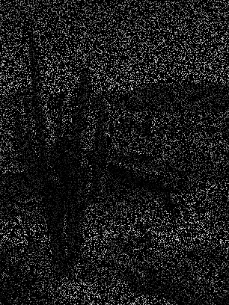
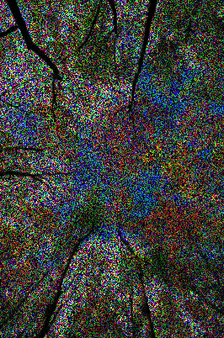
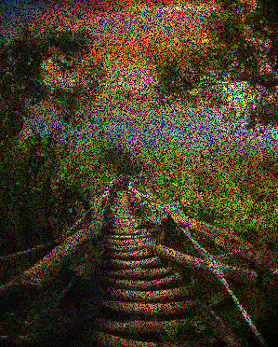
Input Images
80% corrupted
40% corrupted
60% corrupted

Slide 5
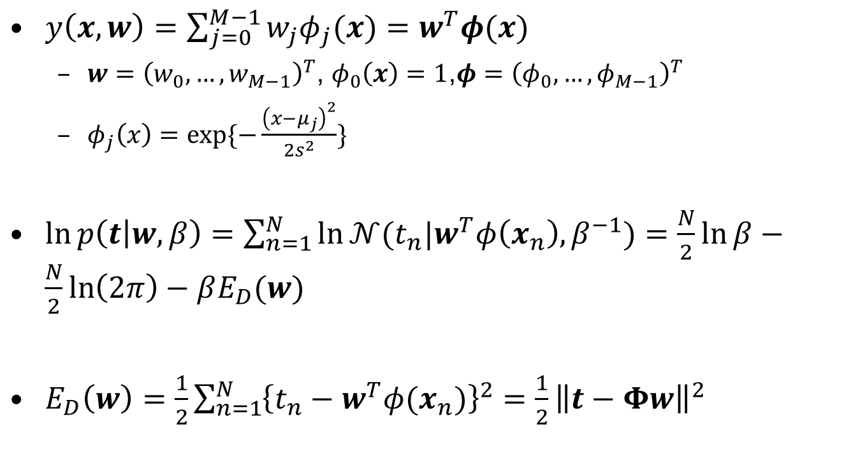
Baseline Linear basis function models
$y\left(x,w\right)=\sum_{j=0}^{M−1}{w_{j}φ_{j}(x)}=w^{T}φ(x)$
$w={\left(w_{0},…,w_{M−1}\right)}^{T}$, $φ_{0}\left(x\right)=1$,$φ={\left(φ_{0},…,φ_{M−1}\right)}^{T}$
$φ_{j}\left(x\right)=exp⁡\{−\frac{{\left(x−μ_{j}\right)}^{2}}{2s^{2}}\}$
$\ln{p\left(t | w,β\right)}=\sum_{n=1}^{N}{\ln{𝒩(t_{n}|w^{T}φ\left(x_{n}\right),β^{−1})}}=\frac{N}{2}\ln{β}−\frac{N}{2}\ln\left(2π\right)−βE_{D}(w)$
$E_{D}\left(w\right)=\frac{1}{2}\sum_{n=1}^{N}{{\left\{t_{n}−w^{T}φ(x_{n})\right\}}^{2}}=\frac{1}{2}{\left\|t−Φw\right\|}^{2}$

Slide 6
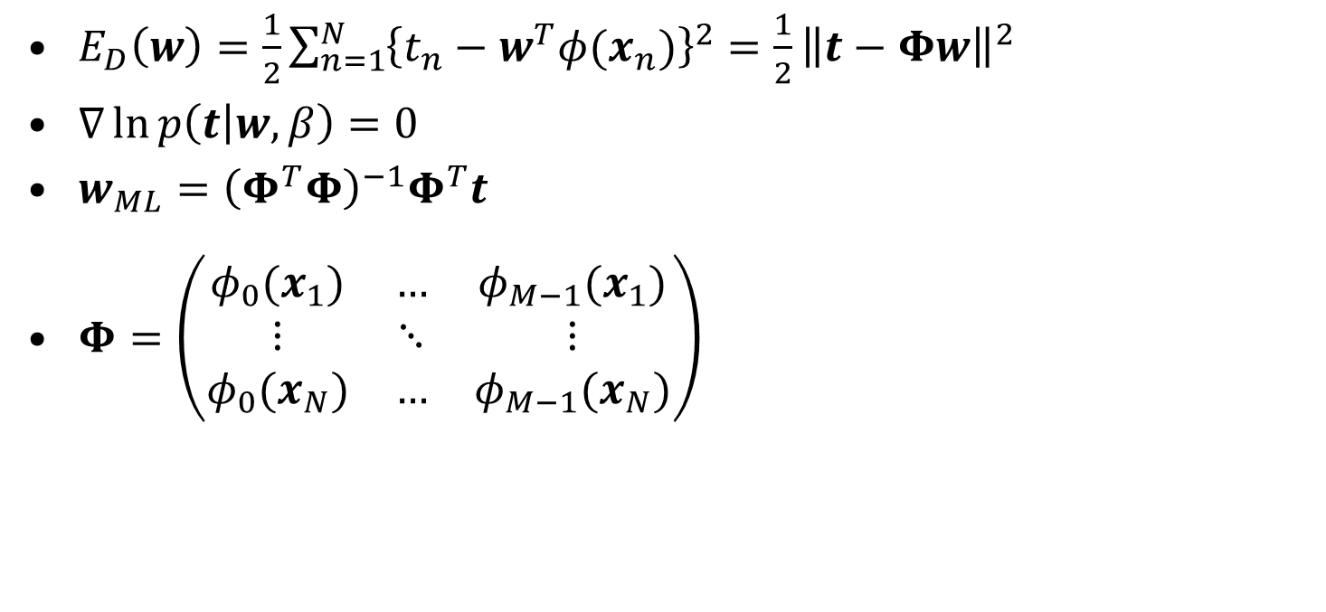
Baseline Linear basis function models
$E_{D}\left(w\right)=\frac{1}{2}\sum_{n=1}^{N}{{\left\{t_{n}−w^{T}φ(x_{n})\right\}}^{2}}=\frac{1}{2}{\left\|t−Φw\right\|}^{2}$
$∇\ln{p\left(t | w,β\right)}=0$
$w_{ML}={\left(Φ^{T}Φ\right)}^{−1}Φ^{T}t$
$Φ=\left(\begin{matrix}φ_{0}(x_{1}) & … & φ_{M−1}(x_{1}) \\ ⋮ & ⋱ & ⋮ \\ φ_{0}(x_{N}) & … & φ_{M−1}(x_{N})\end{matrix}\right)$

Slide 7








Baseline – by line
0 | 53 | 0 | 149 | 0
0 | 13 | 0 | 0 | 0
0 | 0 | 0 | 0 | 0
60 | 135 | 0 | 0 | 0
0 | 0 | 0 | 0 | 0
0 | 1 | 0 | 1 | 0
0 | 1 | 0 | 0 | 0
0 | 0 | 0 | 0 | 0
1 | 1 | 0 | 0 | 0
0 | 0 | 0 | 0 | 0
0 | 0 | 142 | 0 | 0
62 | 0 | 0 | 130 | 0
0 | 0 | 172 | 0 | 0
58 | 0 | 0 | 118 | 0
0 | 0 | 0 | 0 | 0
0 | 0 | 1 | 0 | 0
1 | 0 | 0 | 1 | 0
0 | 0 | 1 | 0 | 0
1 | 0 | 0 | 1 | 0
0 | 0 | 0 | 0 | 0
69 | 0 | 0 | 134 | 99
0 | 0 | 0 | 0 | 105
0 | 76 | 158 | 0 | 40
0 | 122 | 0 | 0 | 0
81 | 0 | 0 | 110 | 0
$$X!=0$$
1 | 0 | 0 | 1 | 1
0 | 0 | 0 | 0 | 1
0 | 1 | 1 | 0 | 1
0 | 1 | 0 | 0 | 0
1 | 0 | 0 | 1 | 0
Corrupted image $X$
Noise mask $\tilde{M}$
69 | 0 | 0 | 134 | 99
1 | 0 | 0 | 1 | 1
0 | 0.25 | 0.5 | 0.75 | 1
$$x$$
$$w_{ML}={\left(Φ_{p}^{T}Φ_{p}\right)}^{−1}Φ_{p}^{T}t_{p}$$
$$Φ_{p}=\left(\begin{matrix}φ_{0}(x_{p1}) & … & φ_{M−1}(x_{p1}) \\ ⋮ & ⋱ & ⋮ \\ φ_{0}(x_{pN}) & … & φ_{M−1}(x_{pN})\end{matrix}\right)$$
$$t_{n}=w_{ML}^{T}Φ_{n}$$
69 | 134 | 99
0 | 0.75 | 1
0.25 | 0.5
$$t_{p}$$
$$x_{p}$$
$$x_{n}$$

Slide 8
Baseline – by block
0 | 53 | 0 | 149 | 0
0 | 13 | 0 | 0 | 0
0 | 0 | 0 | 0 | 0
60 | 135 | 0 | 0 | 0
0 | 0 | 0 | 0 | 0
0 | 1 | 0 | 1 | 0
0 | 1 | 0 | 0 | 0
0 | 0 | 0 | 0 | 0
1 | 1 | 0 | 0 | 0
0 | 0 | 0 | 0 | 0
0 | 0 | 142 | 0 | 0
62 | 0 | 0 | 130 | 0
0 | 0 | 172 | 0 | 0
58 | 0 | 0 | 118 | 0
0 | 0 | 0 | 0 | 0
0 | 0 | 1 | 0 | 0
1 | 0 | 0 | 1 | 0
0 | 0 | 1 | 0 | 0
1 | 0 | 0 | 1 | 0
0 | 0 | 0 | 0 | 0
69 | 0 | 0 | 134 | 99
0 | 0 | 0 | 0 | 105
0 | 76 | 158 | 0 | 40
0 | 122 | 0 | 0 | 0
81 | 0 | 0 | 110 | 0
$$X!=0$$
1 | 0 | 0 | 1 | 1
0 | 0 | 0 | 0 | 1
0 | 1 | 1 | 0 | 1
0 | 1 | 0 | 0 | 0
1 | 0 | 0 | 1 | 0
Corrupted image $X$
Noise mask $\tilde{M}$

Slide 9
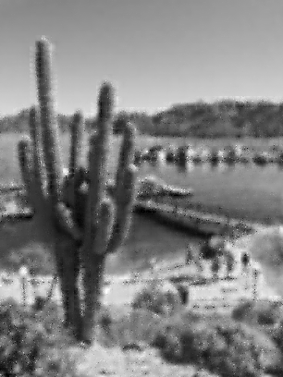
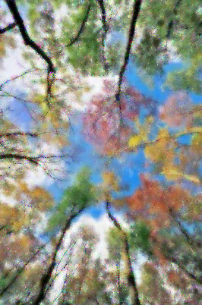
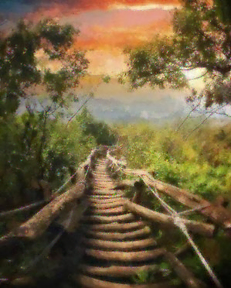
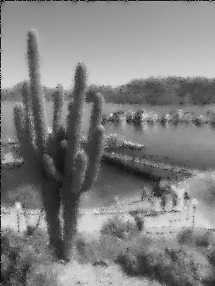

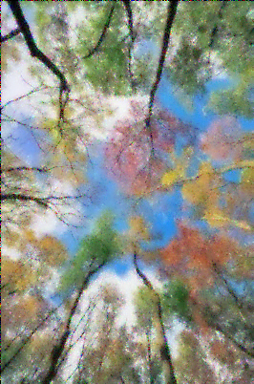
Previous Examples
Restored images:
Corresponding errors:
70.05
77.02

